Slide 1
What is Brain Plasticity? How does it work? Why is it important?
Suliana Gonzalez

Slide 2
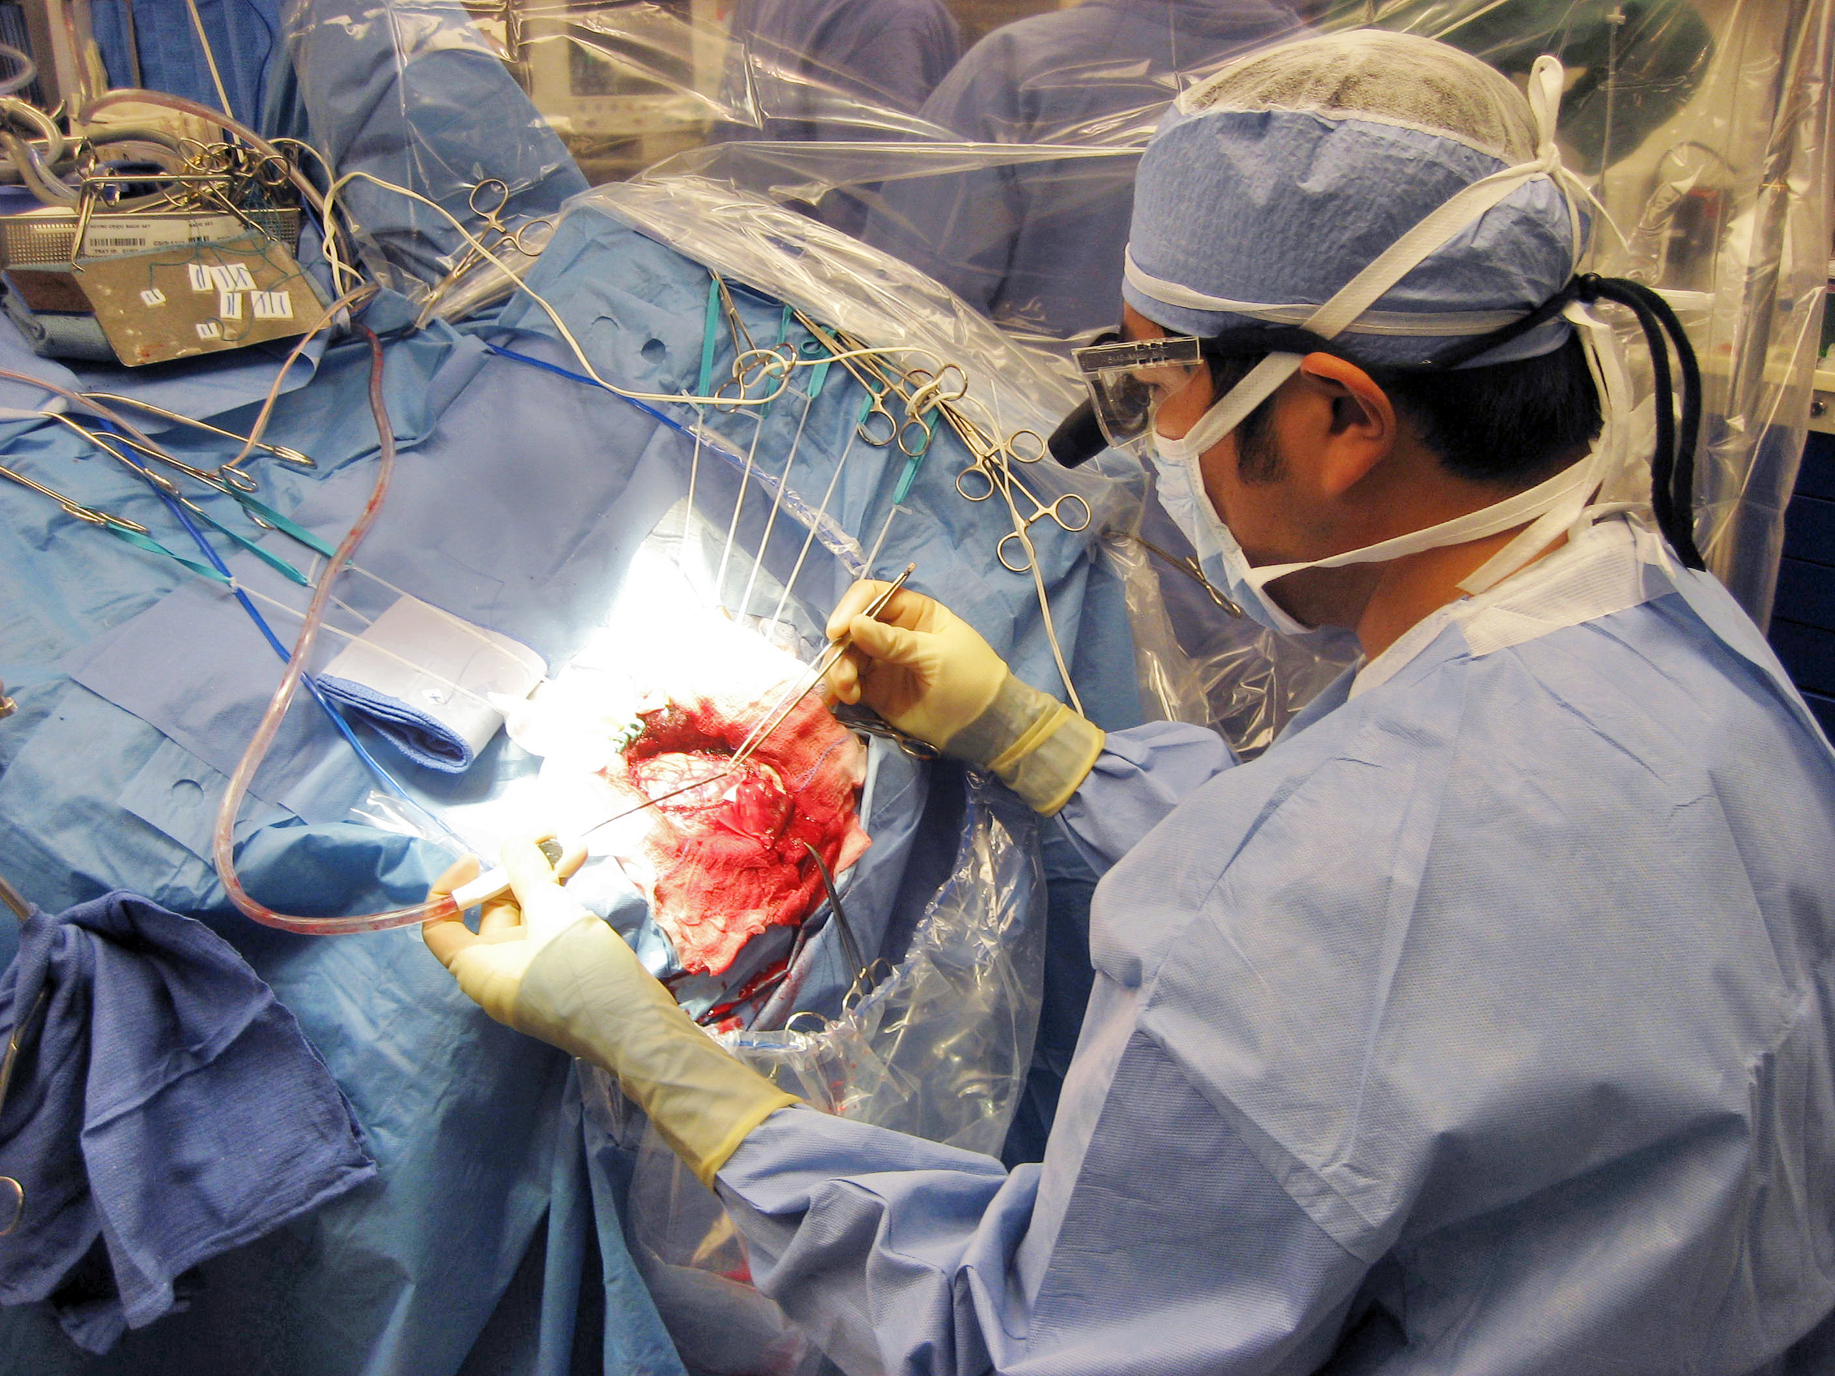
Why I chose this
I want to be a neurosurgeon, find the brain fascinating
Younger sister gets seizures
Would read about the brain because of this

Slide 3
What is Brain Plasticity?
DEFINITION – The brain’s ability to modify its own structure and function after changes in the body and external environment.
Mostly happens in outer region of brain known as grey matter
Brain plasticity is more easily done in children than in adults

Slide 4
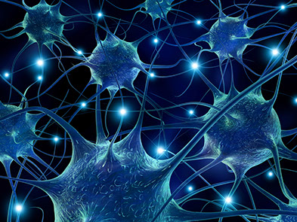
How Does it Work?
Simplest explanation – when new neurological pathways are formed
Happens when something new is learned.

Slide 5
Children VS. Adults
Children
Adults
Barely creating neuropathways and therefore easy to learn knew things.
No need to make space
Have filled their brains with information, already have neuropaths
Have to go through “pruning back”
Get rid of neuropathways not used often

Slide 6
Why is it important
Used everyday when we come to school
Once untreatable illnesses and traumas can now be treated
Some mild cases, some extreme
https://www.youtube.com/watch?v=VaDlLD97CLM

Slide 7
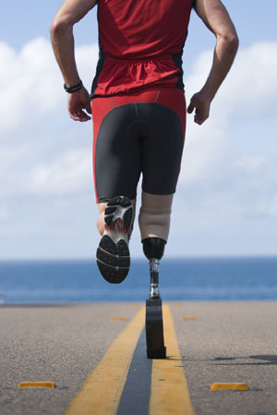
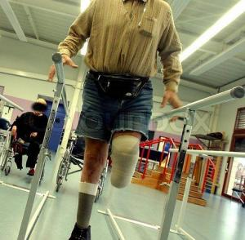
Painful side of Neuroplasticity: Phantom limbs
Brain plasticity may have a role in phantom limb pains
When limb gets amputated brain map jumbles up because nerves get cut off.
Brain doesn’t realize that limb not there so redirects neuropathways.
Near part of body now responsible for feeling what severed limb would feel.

Slide 8
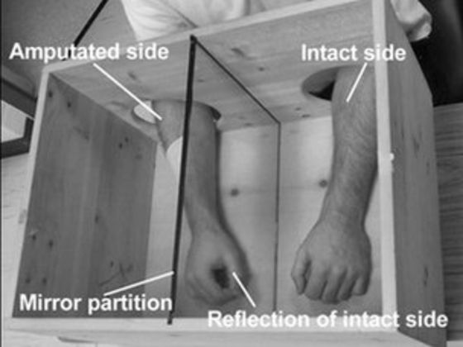
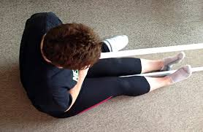
Treatment for Phantom Limbs involves plasticity

